Slide 1

Binomial Heap
Rupali Khare
Assistant Professor, DCEA, GLAU

Slide 2
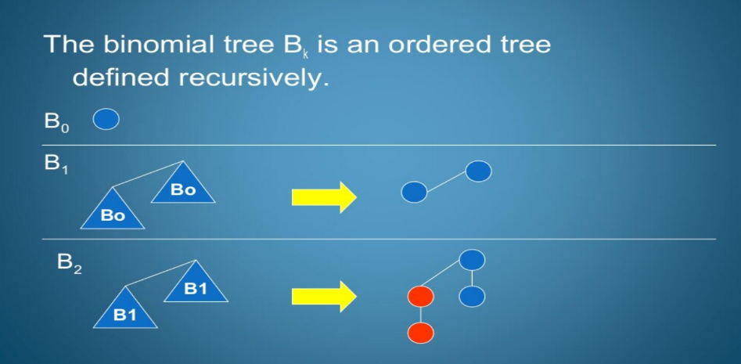
Binomial Tree
A Binomial heap is a collection of Binomial trees.
The Binomial tree is the building block for the binomial heap.
A Binomial tree B_{k} is an ordered tree defined recursively.
The binomial tree B₀ has one node.
The binomial tree B_{k} consist of two binomial tree B_{k} - 1 and they are connected such that the root of one tree is the leftmost child of the other.

Slide 3
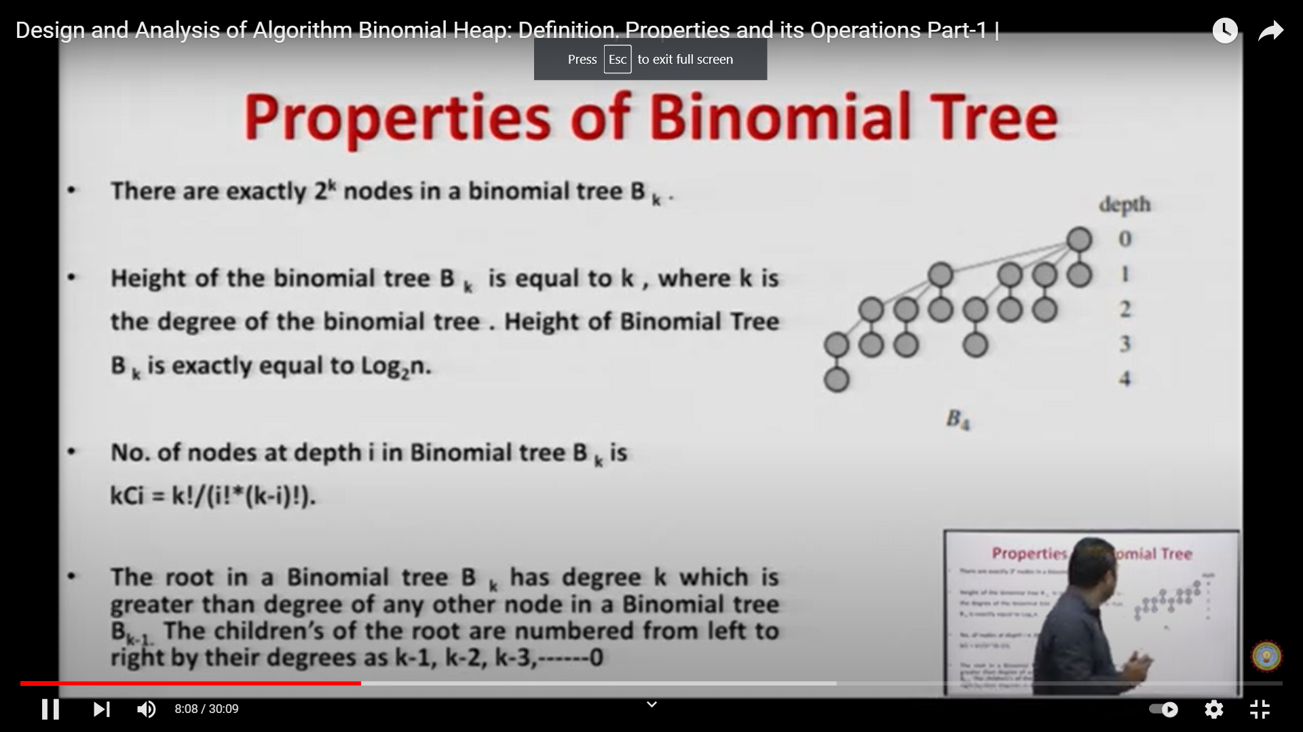
Binomial tree properties-
B_{k} has ₂^{k} nodes in a binomial tree B_{k}.
Height of the binomial tree B_{k}, is equal to k,
where k is the degree of the binomial tree.
Height of the Binomial tree B_{k} is exactly equal to Log₂n.
No. of nodes at depth ‘i’ in Binomial tree B_{k} is ^{K}C_{i}= k!/ (i!*(k-1)!)
The root in a binomial tree B_{k} has degree k which is greater than degree of any other node in a Binomial tree B_{k} -1.
The children's of the root are numbered from left to right by their degrees as k-1, k-2, k-3,…….0.

Slide 4

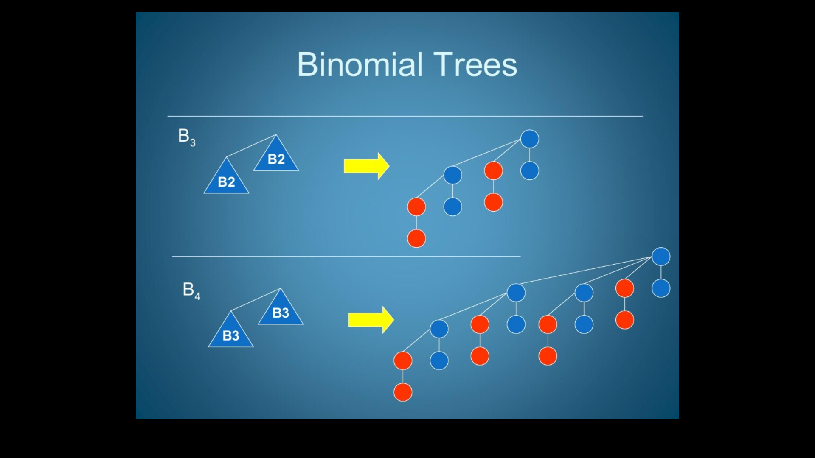
Binomial tree

Slide 5
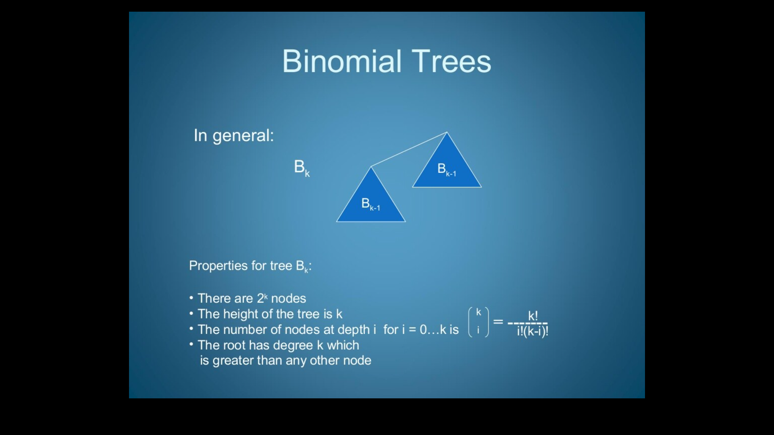

Slide 6
Binomial Heap
A Binomial heap H is a set of binomial trees that satisfies the following binomial heap properties.
Each binomial tree in H obeys the min heap property.
For any nonnegative integer k, there is at most one binomial tree in H whose root has degree k.
The number of trees in a n node binomial heap is O(logn).
Binomial trees will be joined by a linked list of the roots.
The binary heap data structure is fine for the simple operations of inserting, deleting and extracting elements, but other operations aren't so well supported. One such operation is the union operation, which joins two heap together.
Binomial heap presents the data structure which supports Union operations more efficiently.

Slide 7
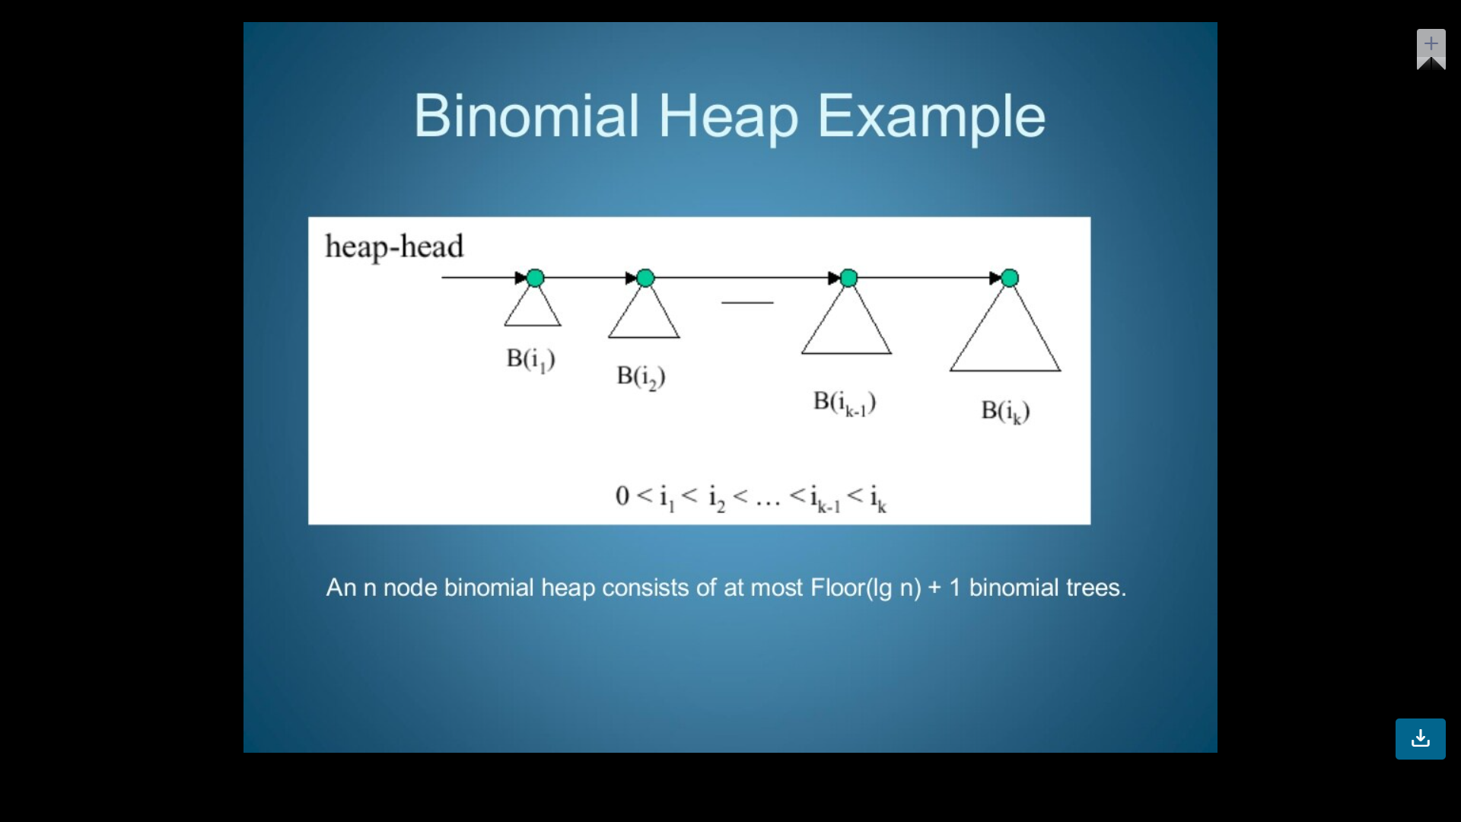

Slide 8
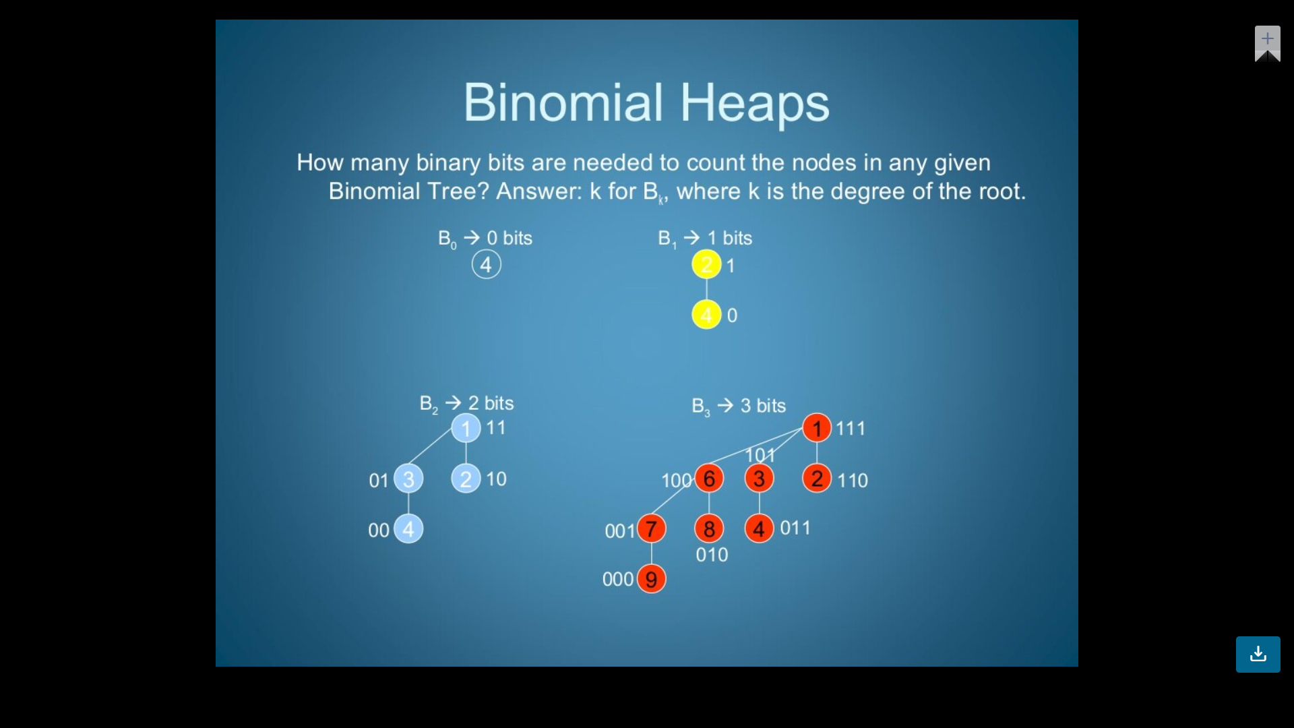
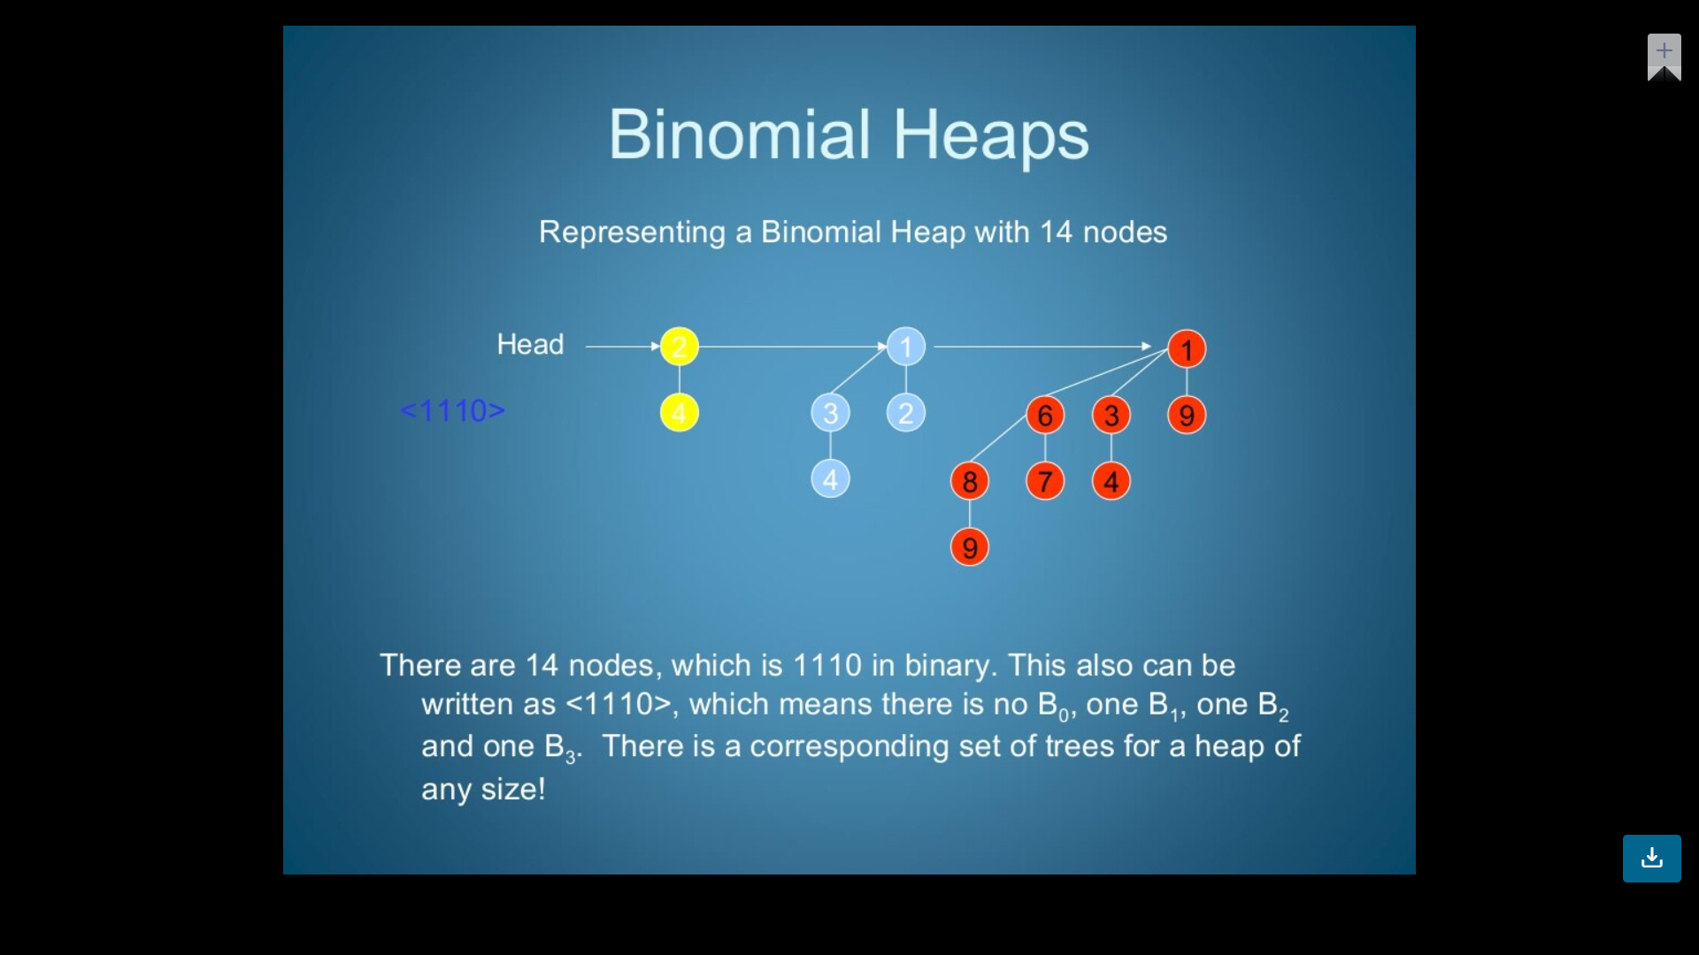
Binomial Heap

Slide 9
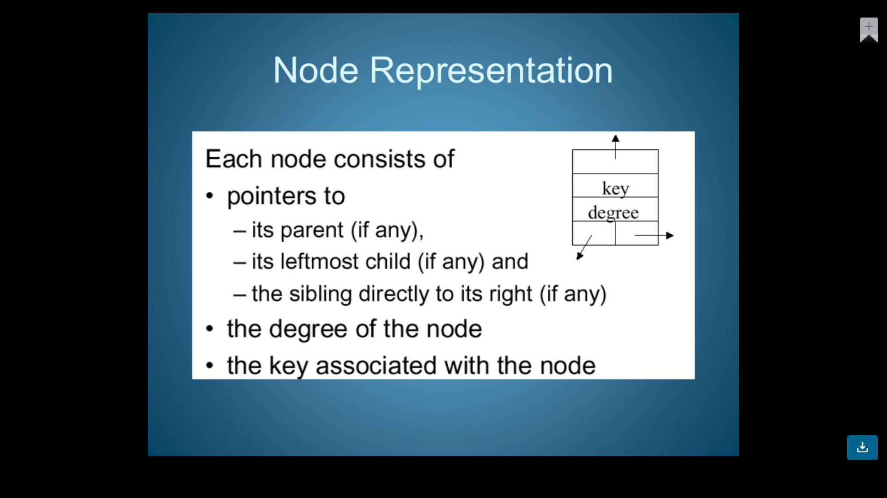
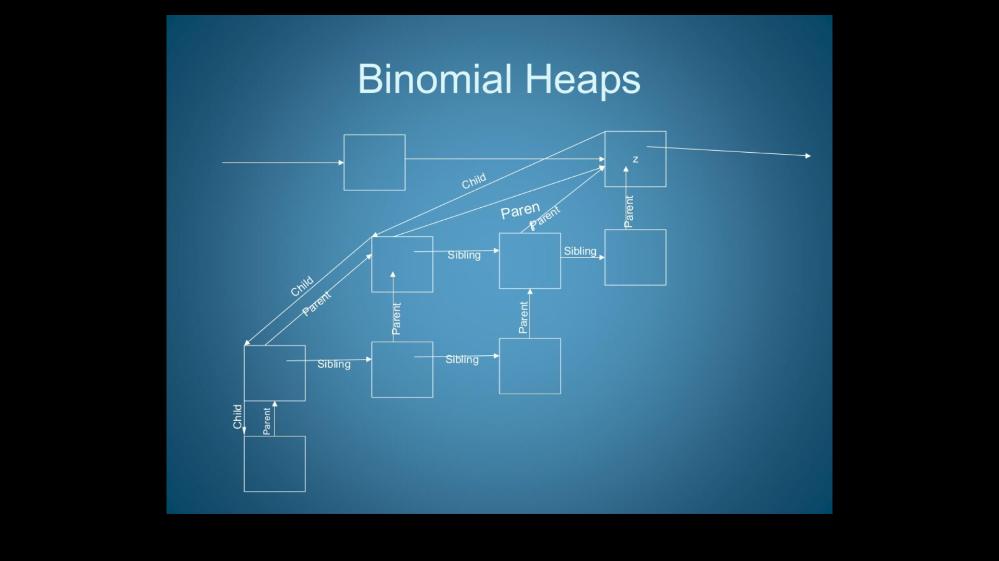
Node representation

Slide 10
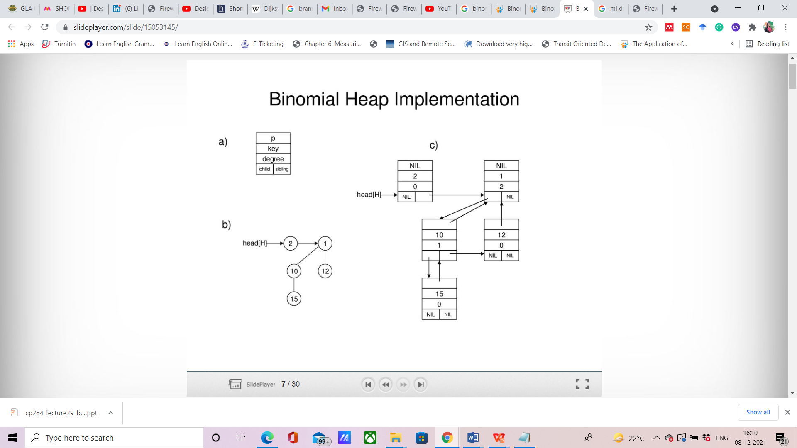
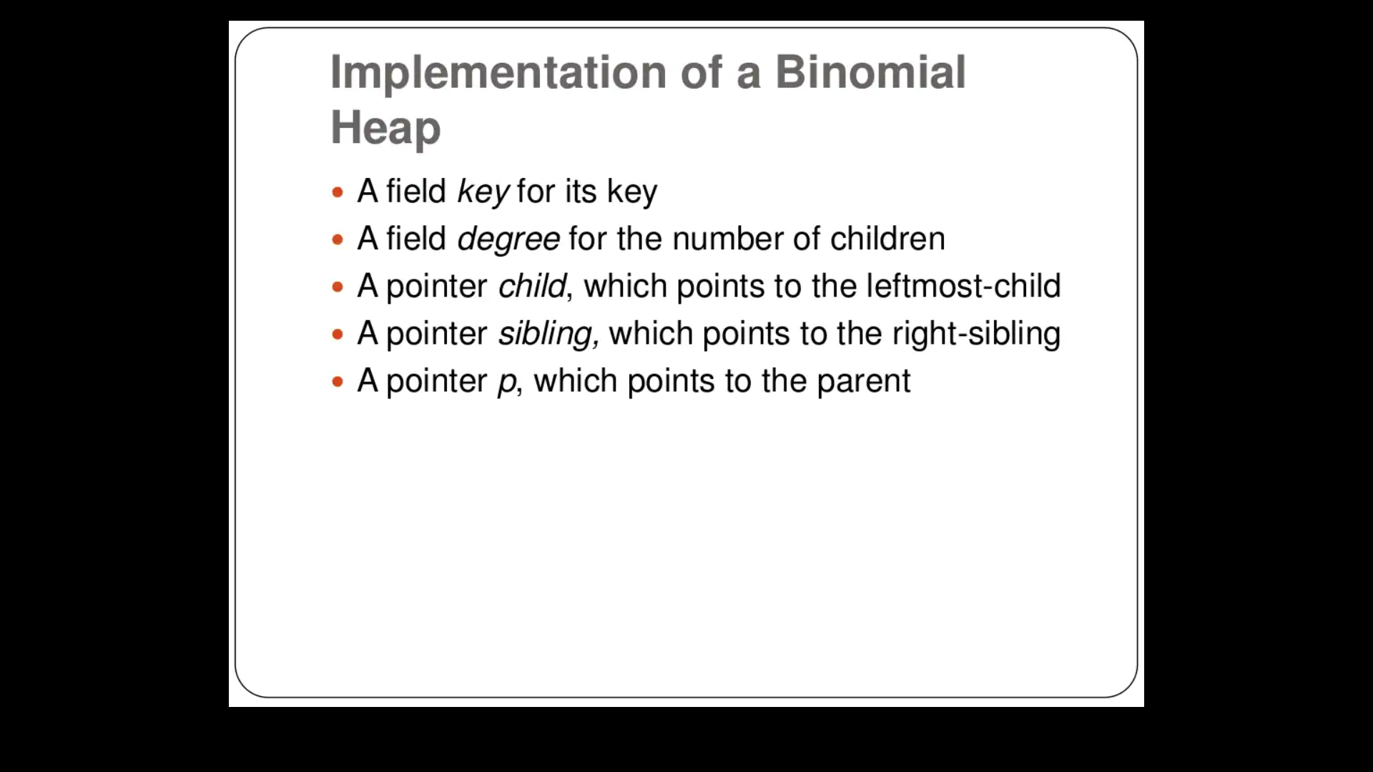

Slide 11
Binomial Heap Operations
Create Heap
Union two binomial heap
Insert a node
Find minimum key
Extract minimum node
Decrease a key value of a node
Delete a node

Slide 12
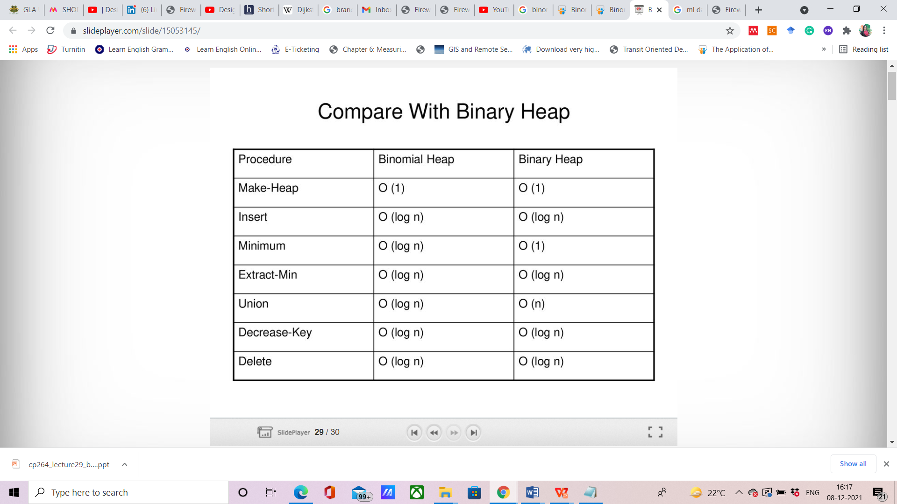
Compare with Binary Heap

Slide 13
Create New Binomial Heap
Binomial Heap is created using MAKE BINOMIAL HEAP procedure.
Allocate heap is used to obtain the memory for new heap.
1. H<- Allocate Heap()
2. Head [H] <- NIL
3. Return NIL
O(1) runtime

Slide 14
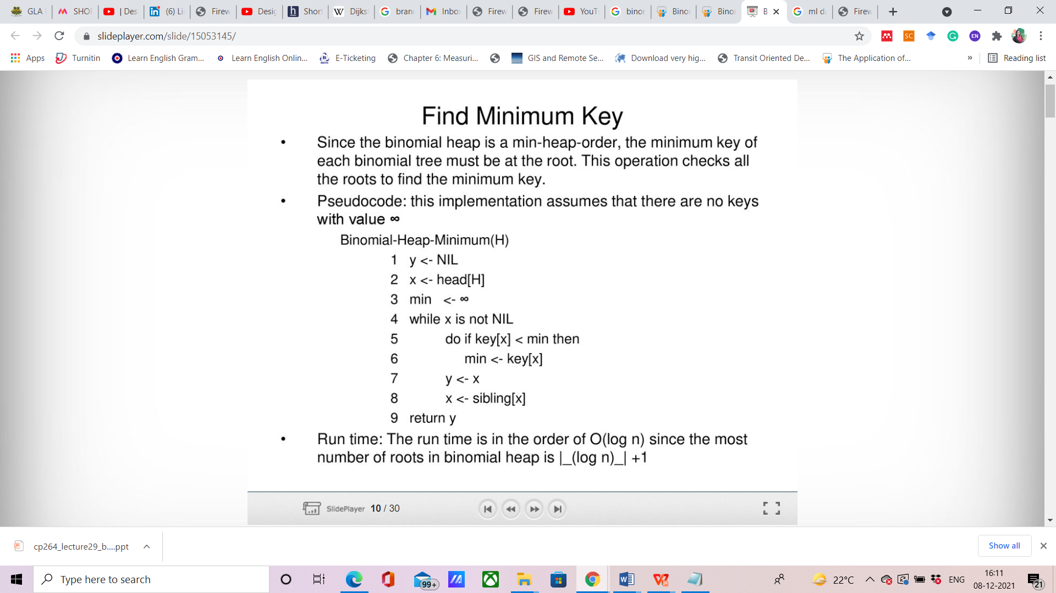
Finding Minimum key in Binomial Heap

Slide 15
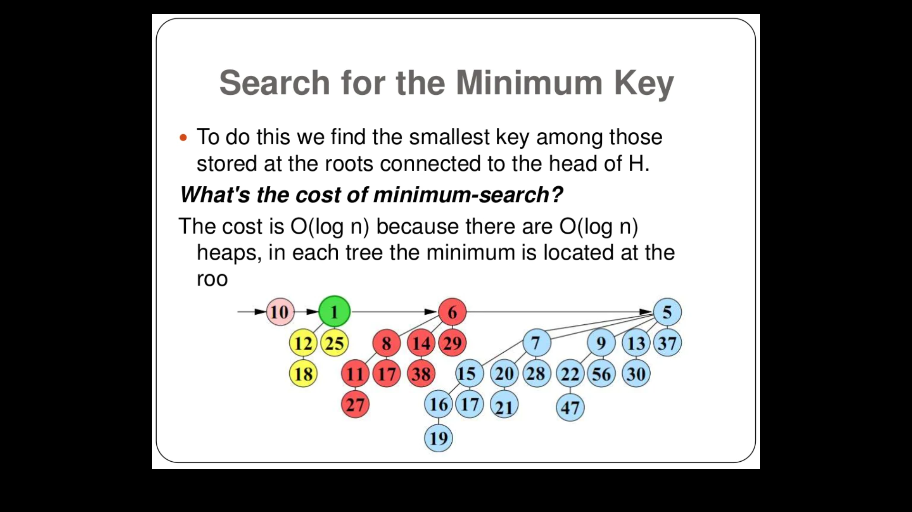

Slide 16
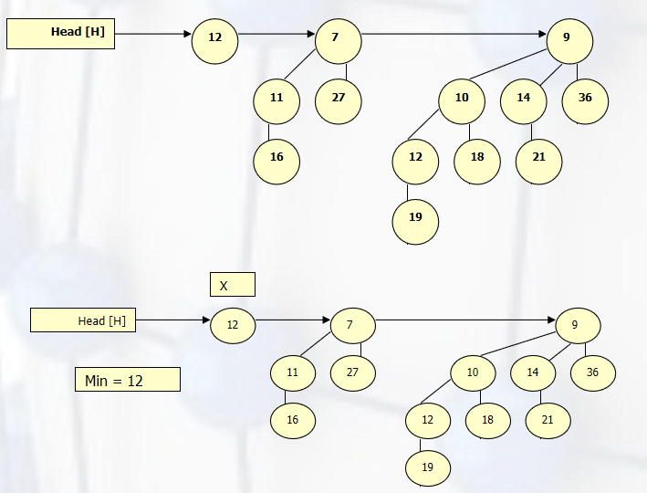
Example

Slide 17
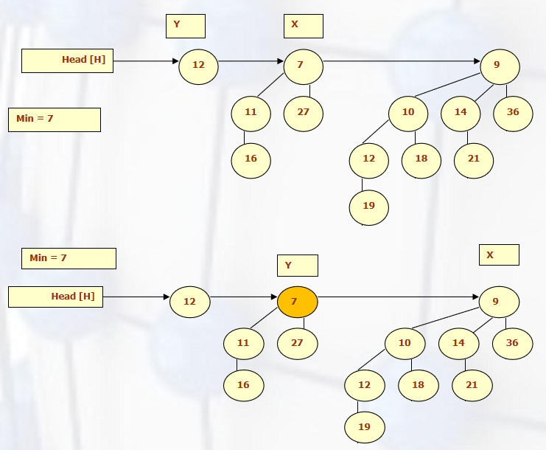
Conti..

Slide 18
Union of Binomial Heap
Union of binomial heaps consists of the following steps-
1. Merge two binomial heaps H1 and H2. The resulting heap has the roots in the increasing order of the degree.
2. For each tree in the binomial heap H, if it has the same order with another tree, link the two nodes together such that the resulting tree obeys the min heap- order.
3. This operation has four different cases which area as described in the next slide.
The complexity of this operation is O(log n).

Slide 19
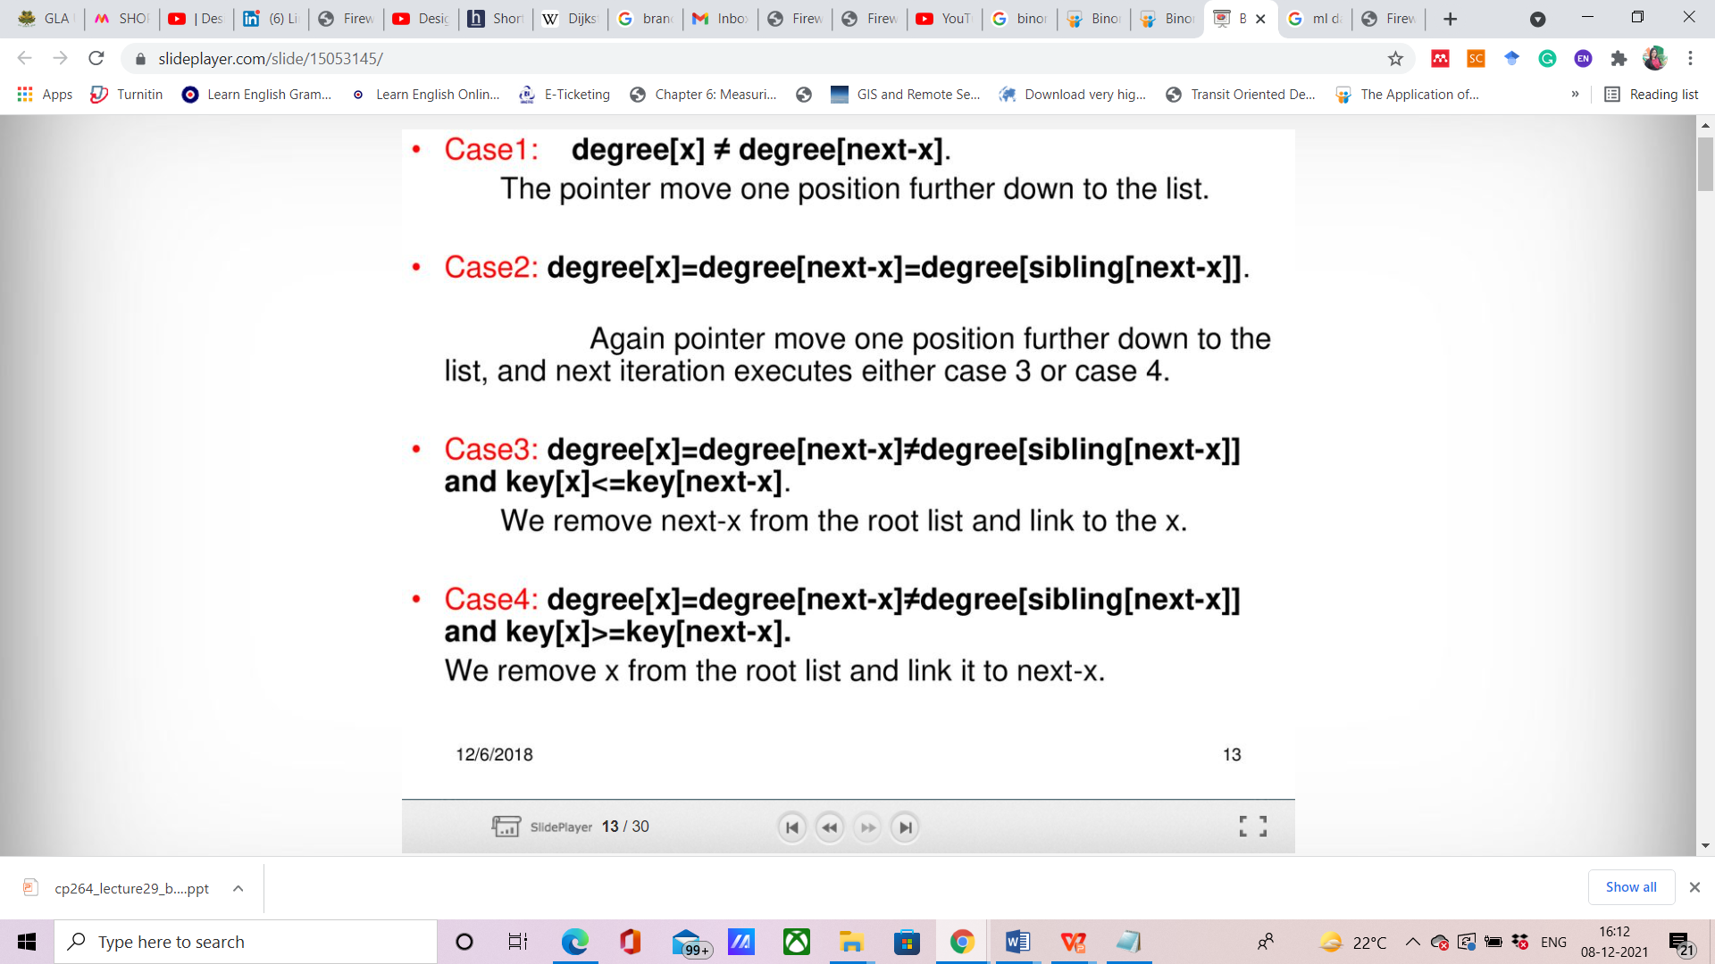

Slide 20
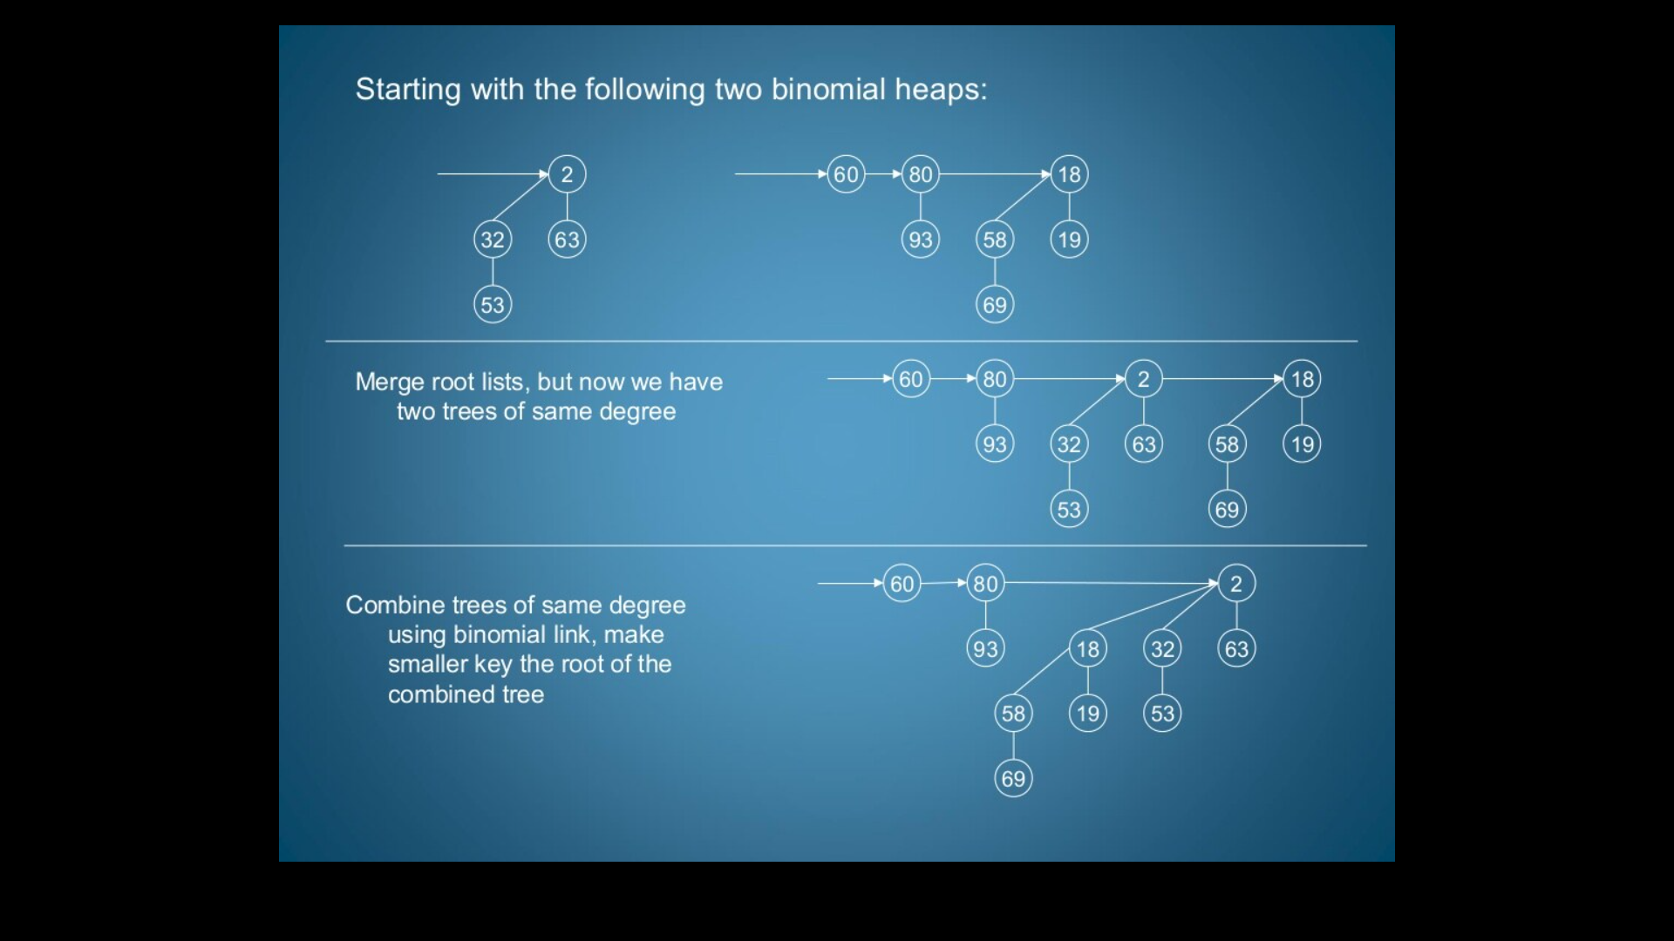

Slide 21
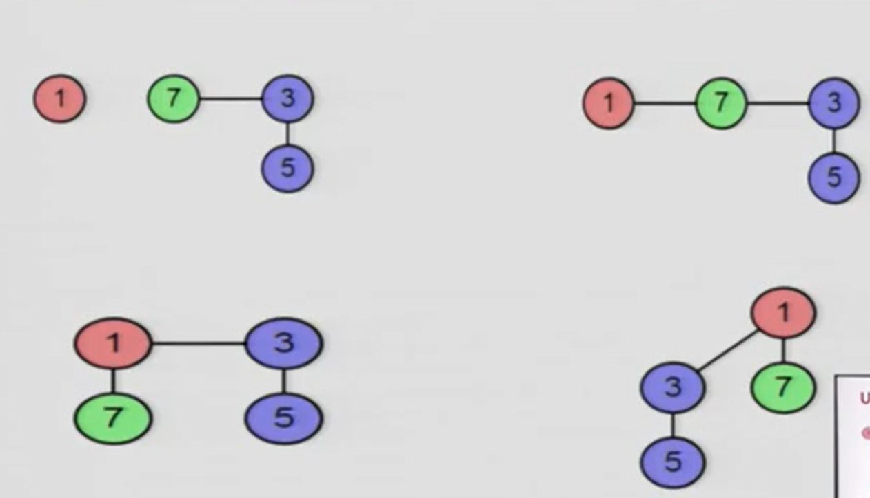
Example

Slide 22
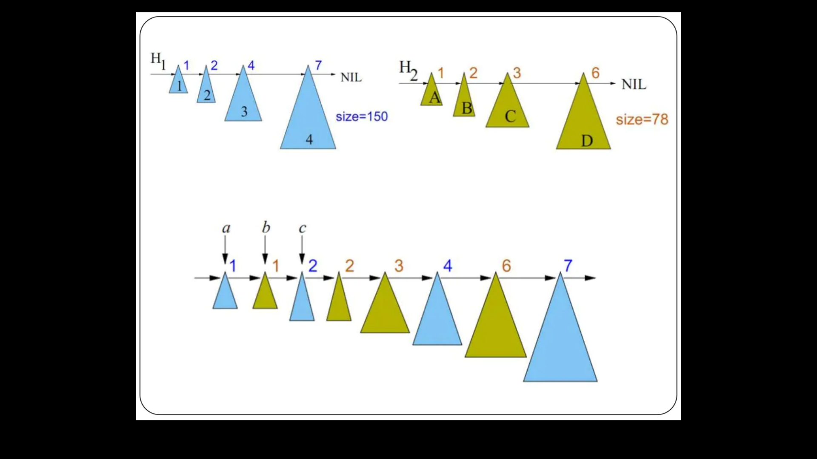

Slide 23
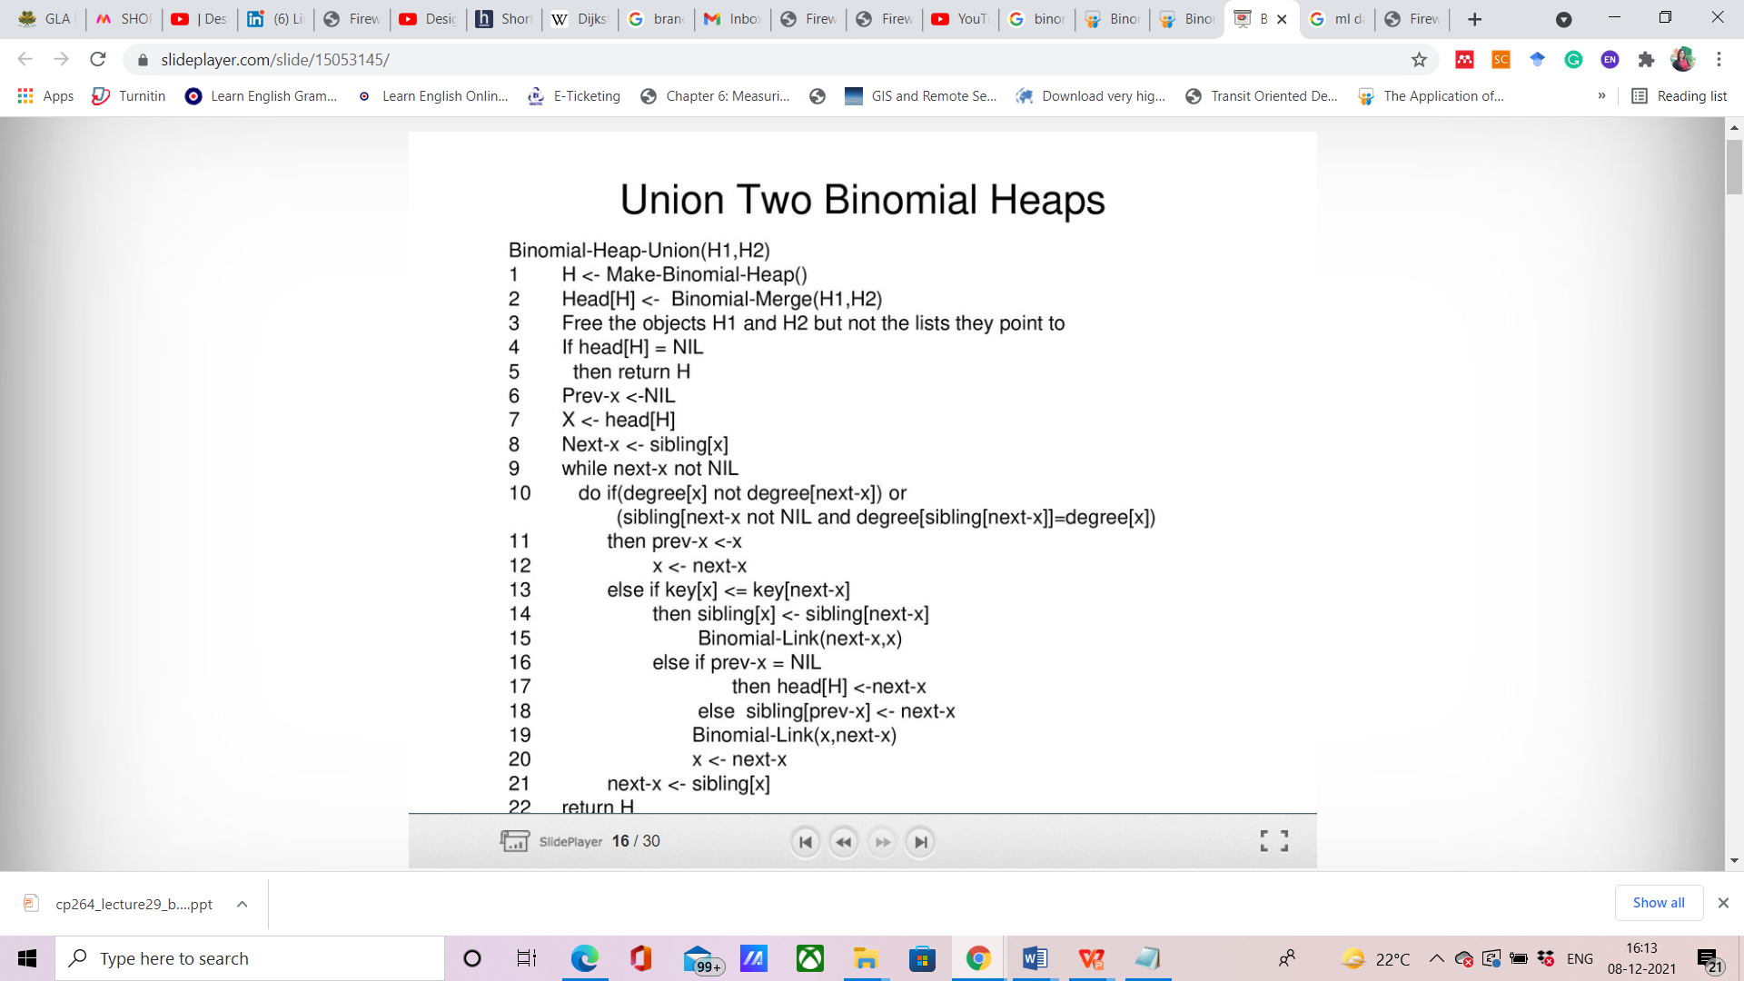

Slide 24
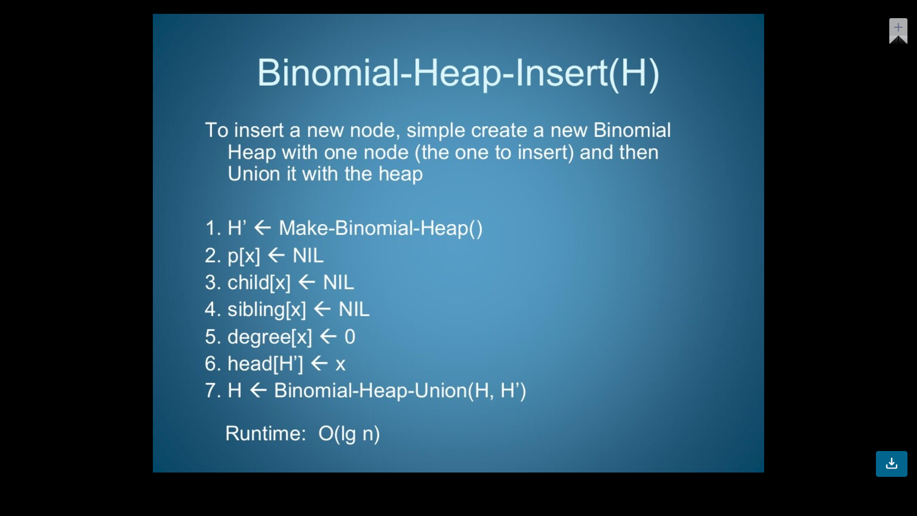
Insert a node

Slide 25
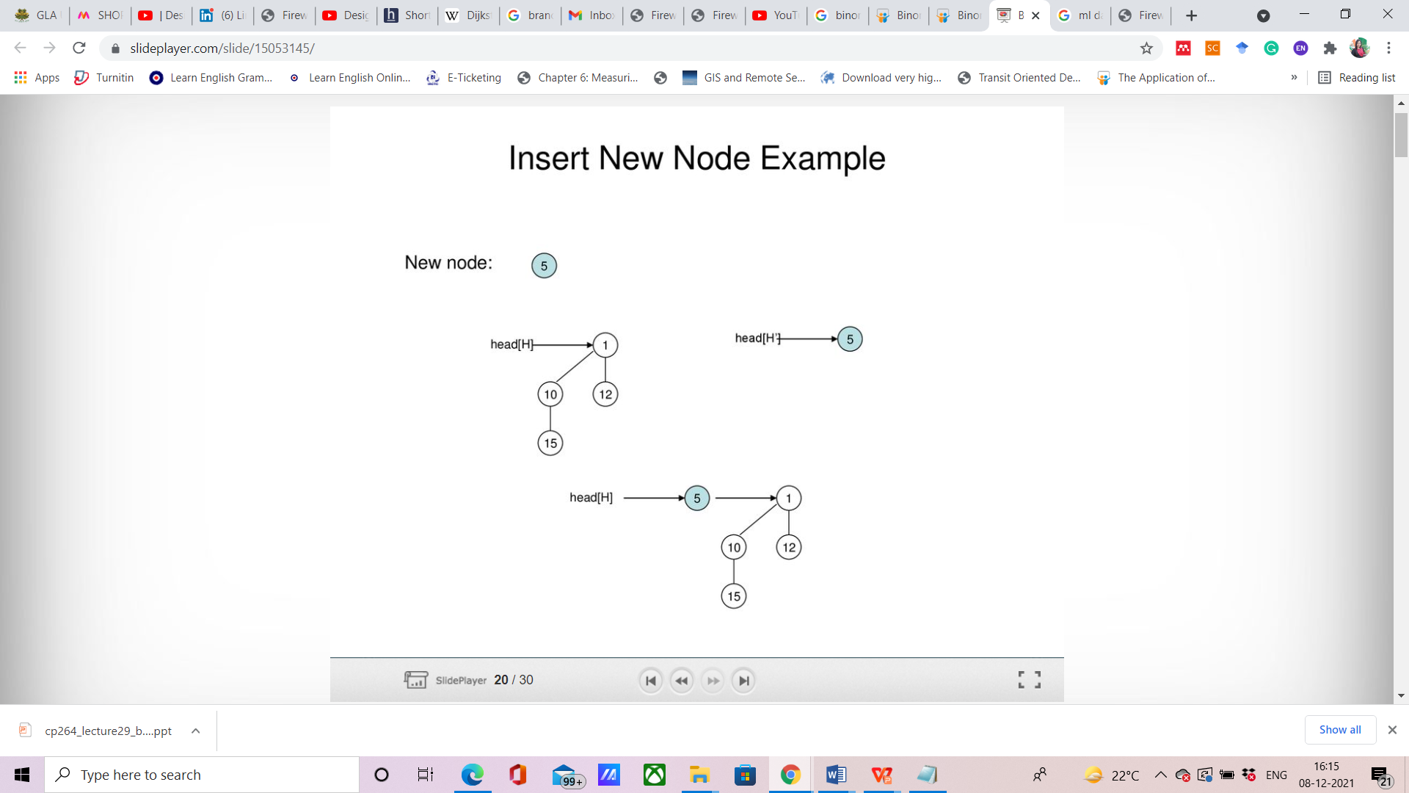
example

Slide 26
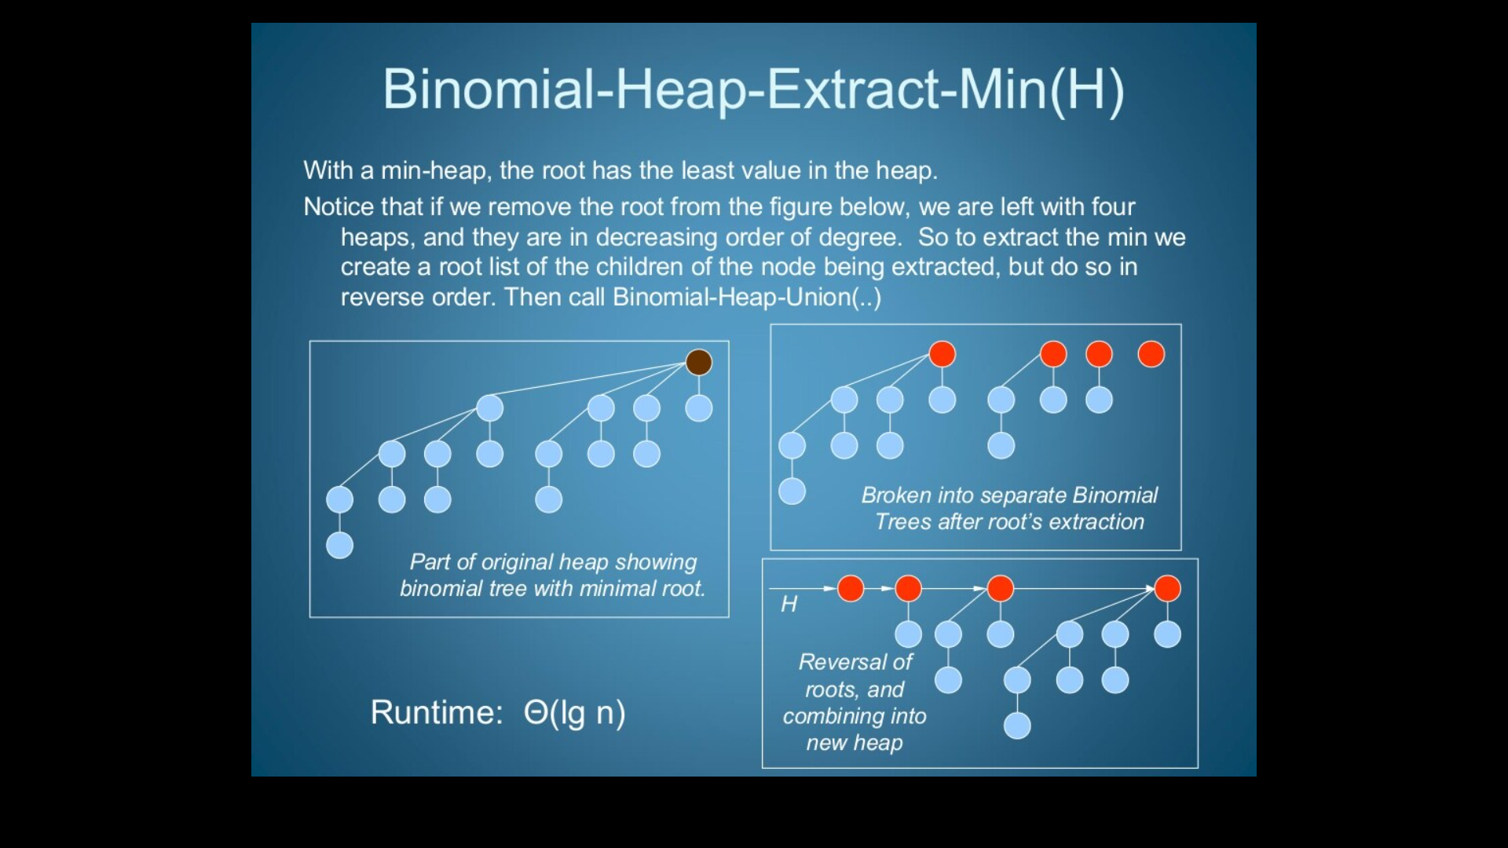
Extract Min

Slide 27
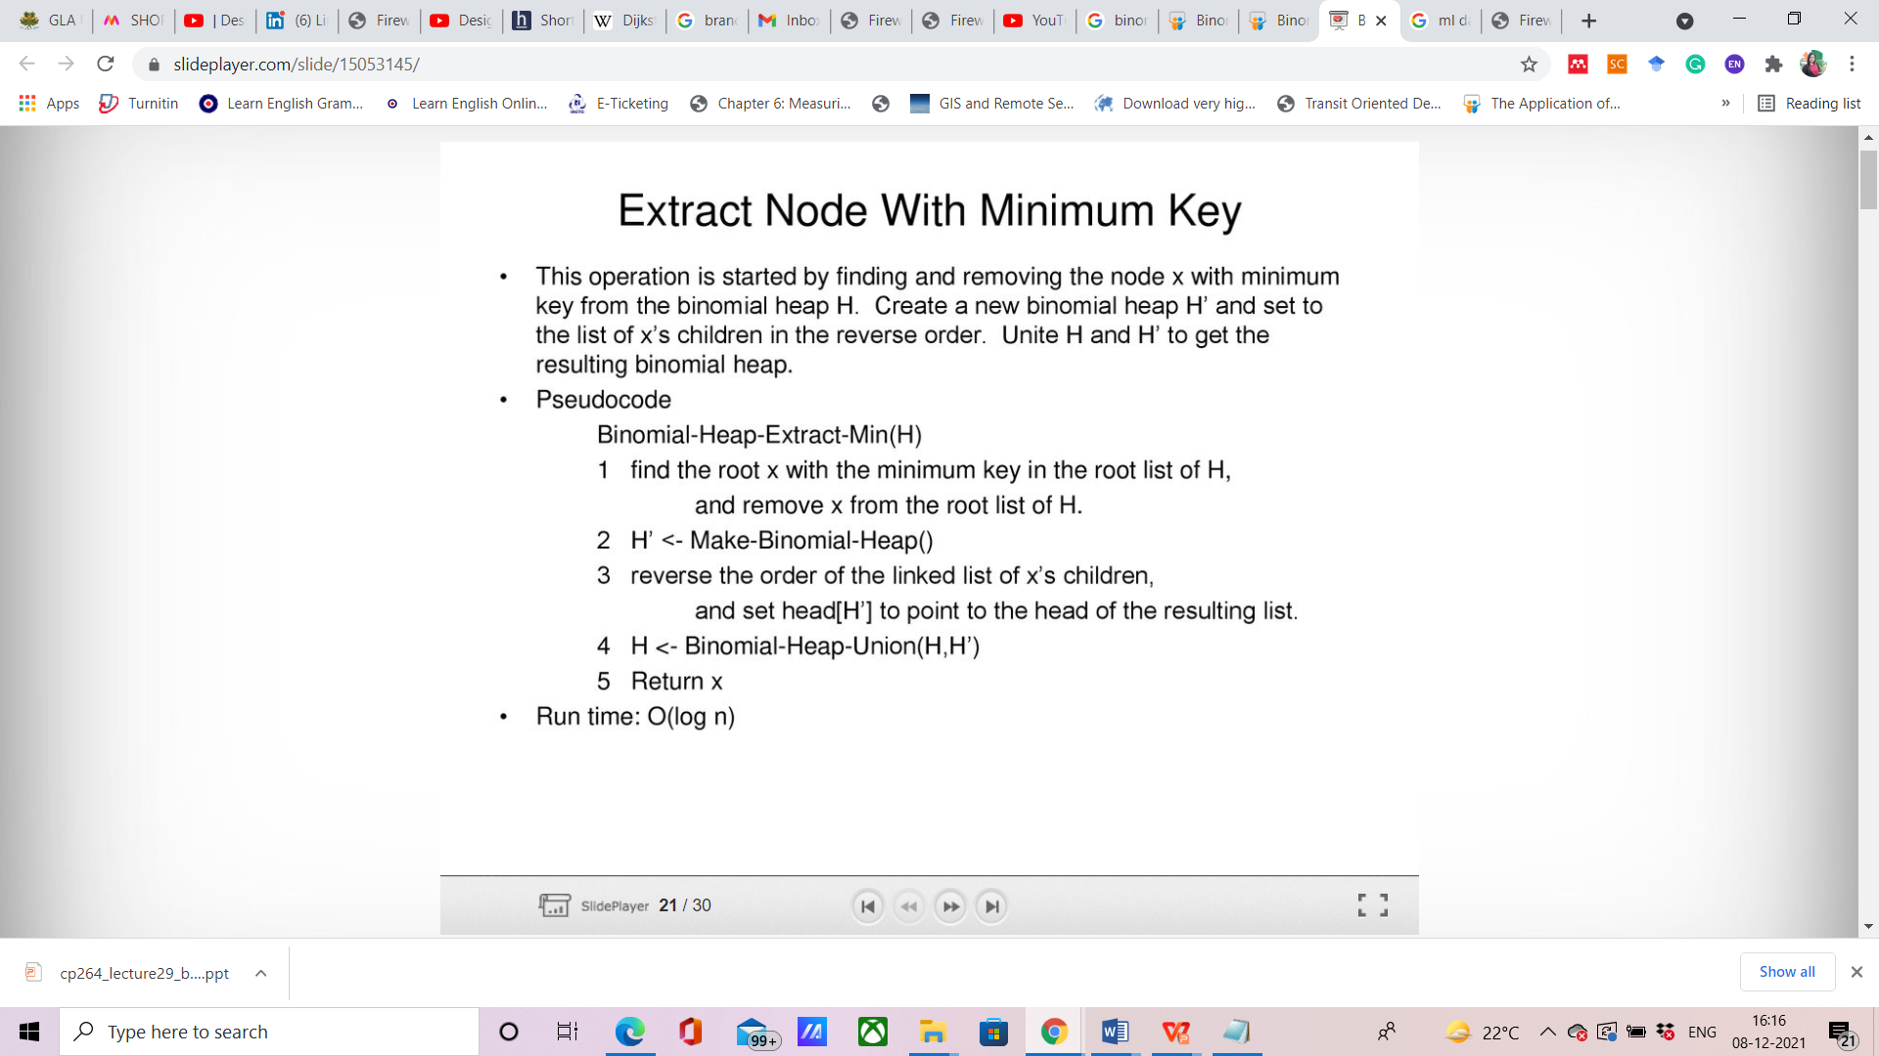
Extract node with minimum key

Slide 28
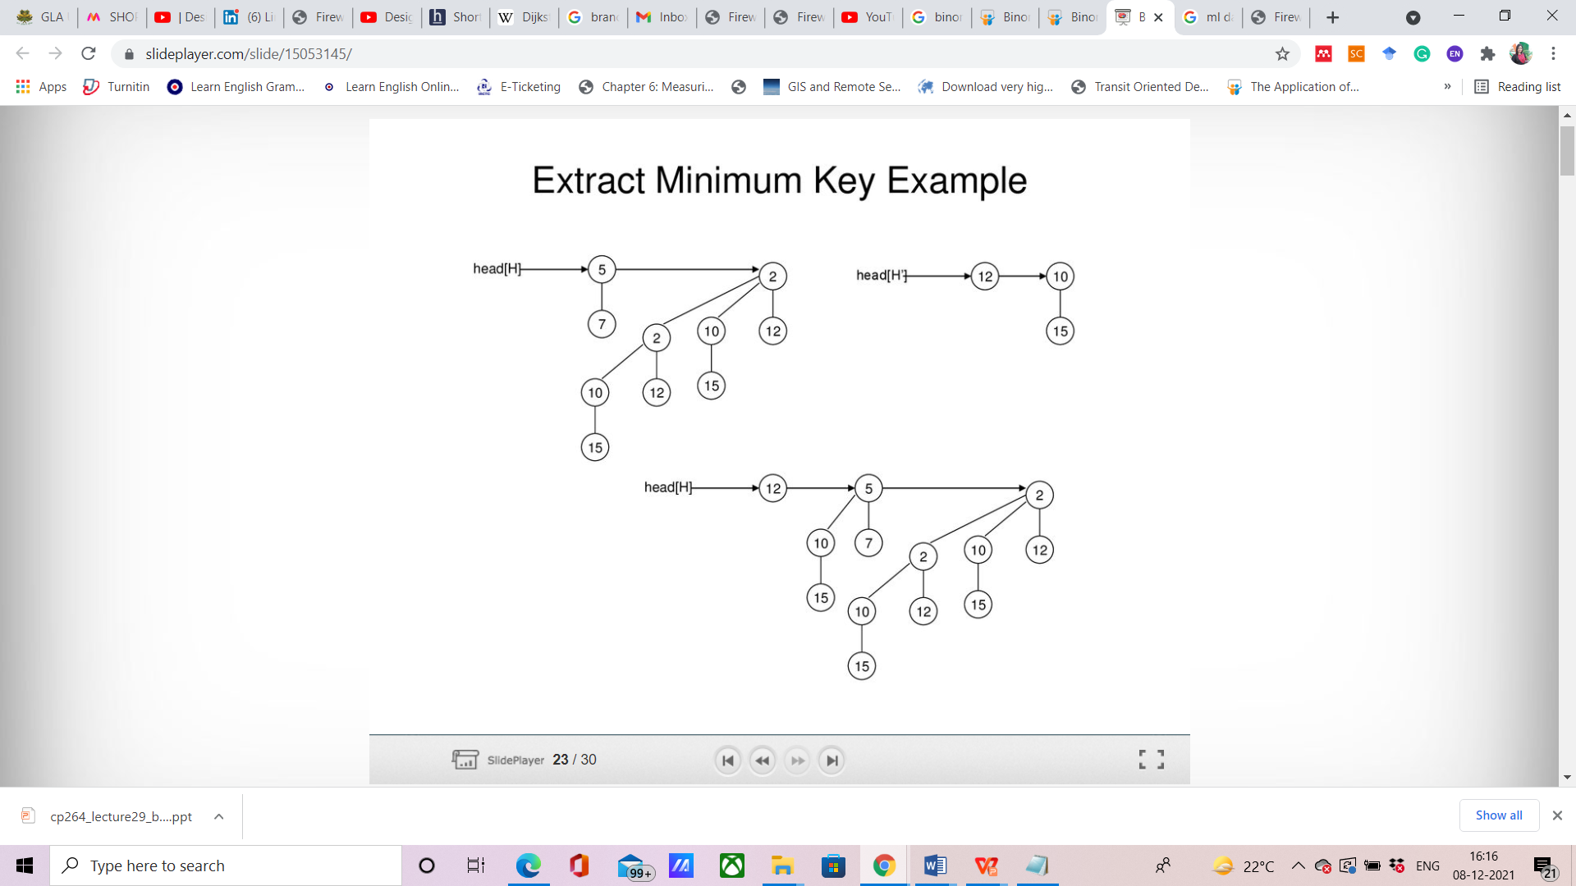

Slide 29
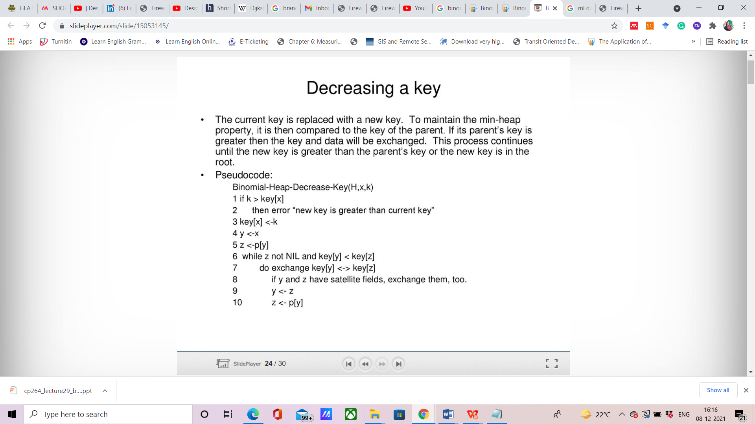
Decreasing a Key value

Slide 30
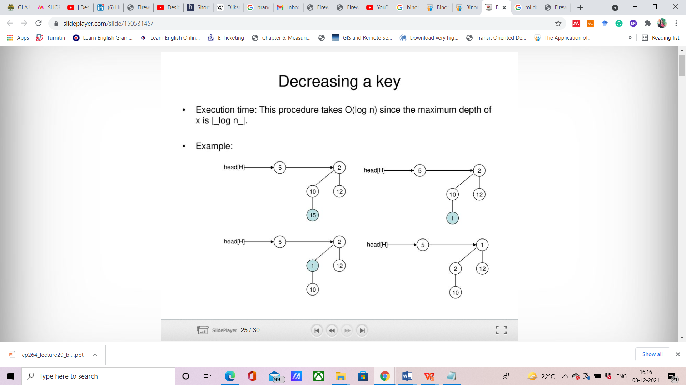

Slide 31
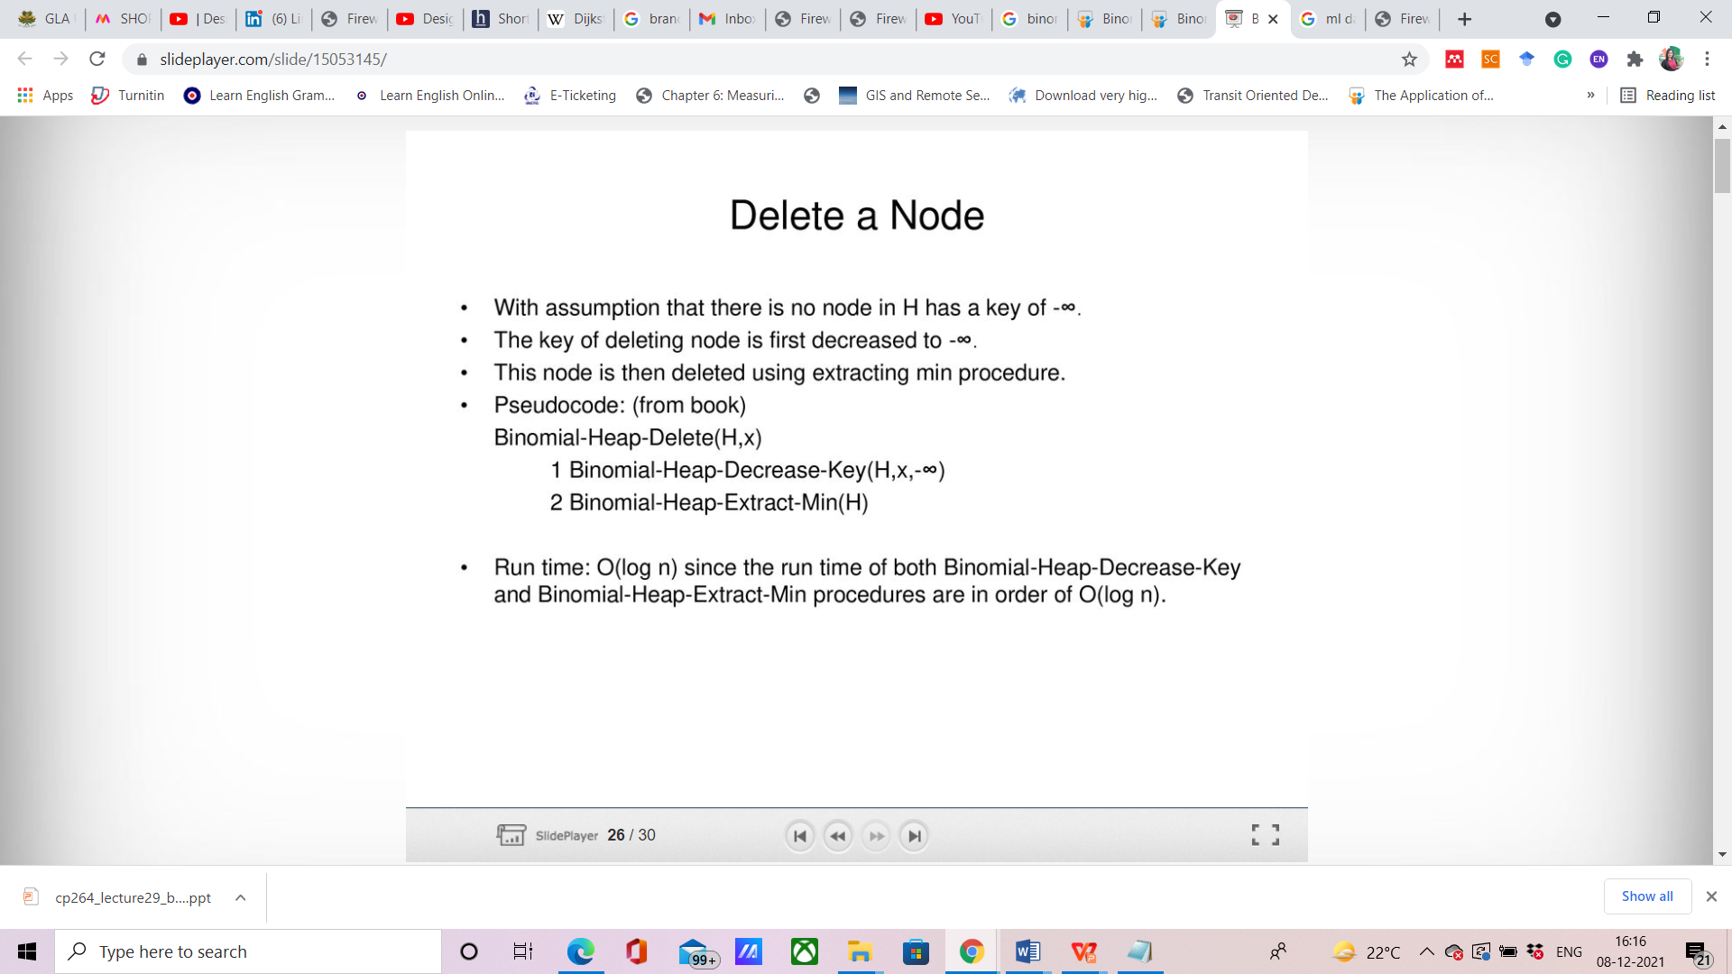
Delete a node

Slide 32
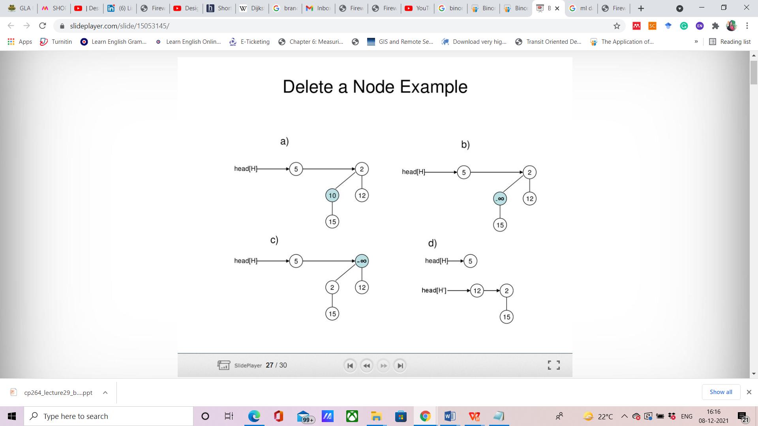

Slide 33
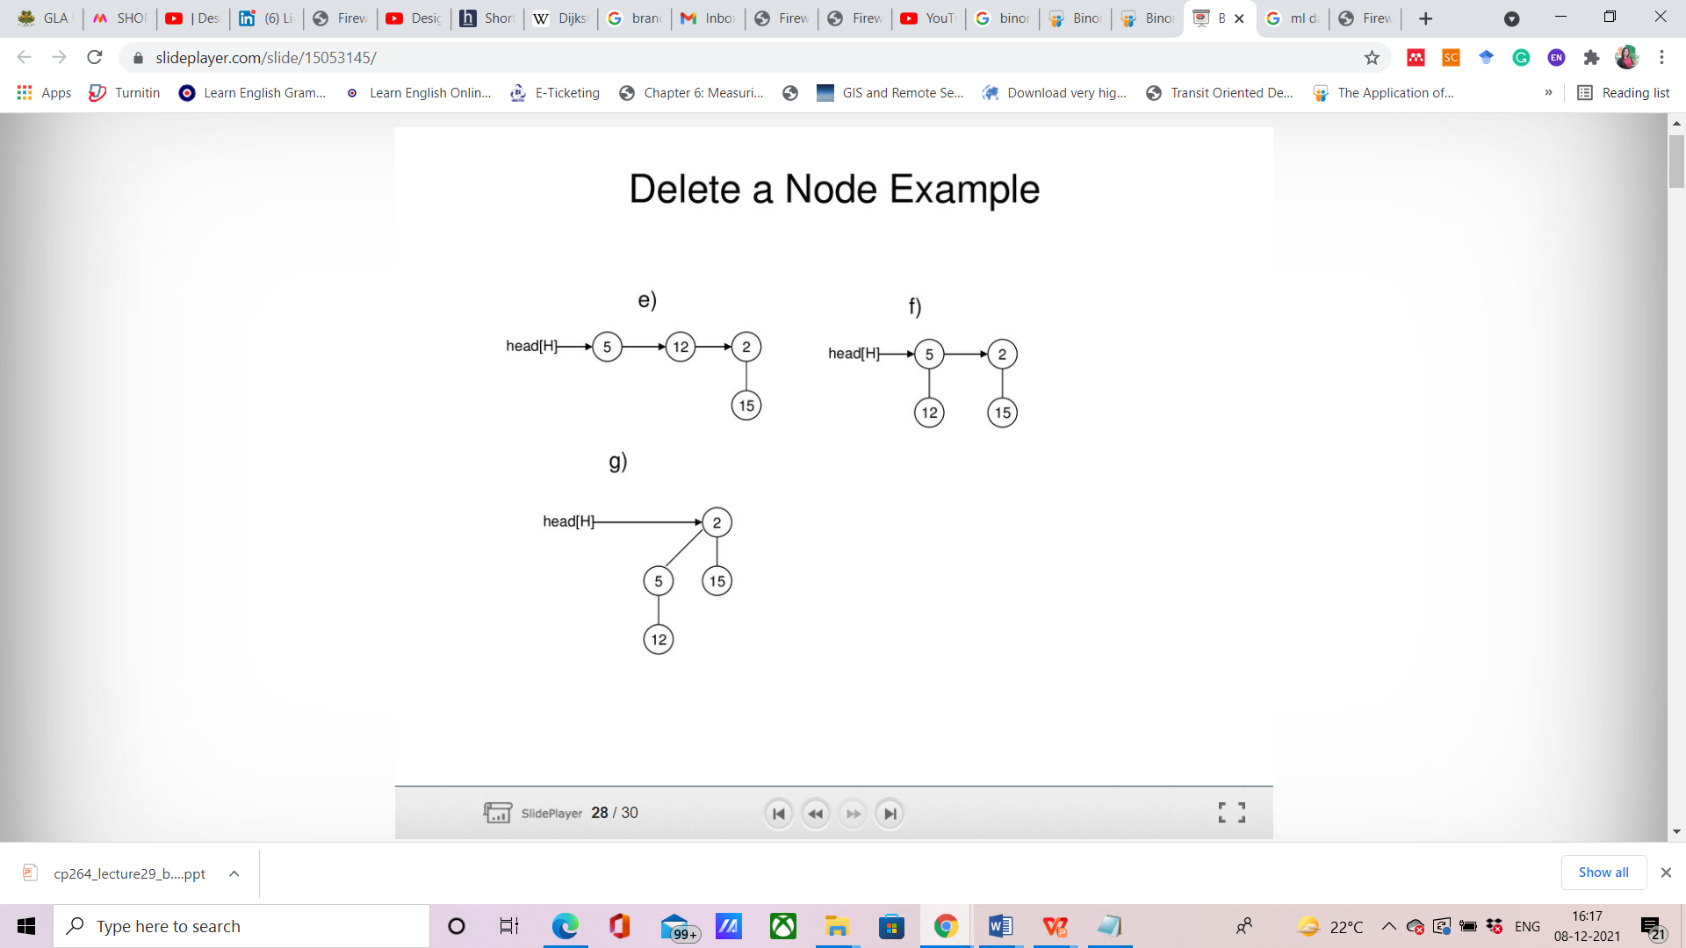

Slide 34
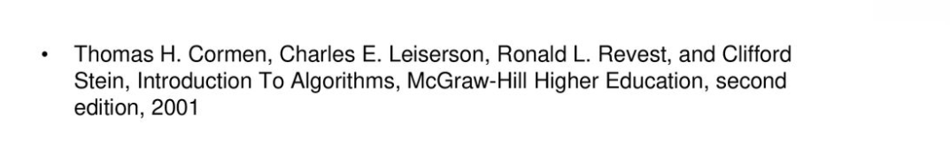
References

